Slide 1




Project: Handwriting Tracking System via mmWave
Presenter: 吉辰卿 华羽霄
SID: 12332152 12010508

Slide 2
01.Intro & Background
Device-free handwriting trajectory reconstruction is an emerging scenario in the field of human-computer interaction (HCI).
There have been a number of works exploiting the channel state information (CSI) estimated for wireless communications in human motion tracking.
However, the sensing performance was constrained by the wavelength of signals. Moreover, the CSI-based sensing methods exhibit high sensitivity to received signal strength. This is because an accurate estimation of CSI is critical for capturing the phase shift due to the finger motions.
As a result, the experiments of handwriting tracking in many exist works were conducted close to both the Wi-Fi transmitter and receivers, where there were line-of-sight (LoS) paths between each other^{[1, 2, 3]}.
Therefore, it is difficult to use CSI information to track the trajectory with high accuracy under NLoS link, where the received signal power is significantly degraded due to the loss in scattering and reflection.
[1] L. Sun, S. Sen, D. Koutsonikolas, and K.-H. Kim, “Widraw: Enabling hands-free drawing in the air on commodity wifi devices,” in Proceedings of the 21st Annual International Conference on Mobile Computing and Networking, 2015, pp. 77–89.
[2]Z. Han, Z. Lu, X. Wen, W. Zheng, J. Zhao, and L. Guo, “Centitrack: Towards centimeter-level passive gesture tracking with commodity wifi,” IEEE Internet of Things Journal, 2023.
[3] L. Wang, K. Sun, H. Dai, A. X. Liu, and X. Wang, “Witrace: Centimeterlevel passive gesture tracking using wifi signals,” in 2018 15th Annual IEEE International Conference on Sensing, Communication, and Networking (SECON). IEEE, 2018, pp. 1–9.

Slide 3
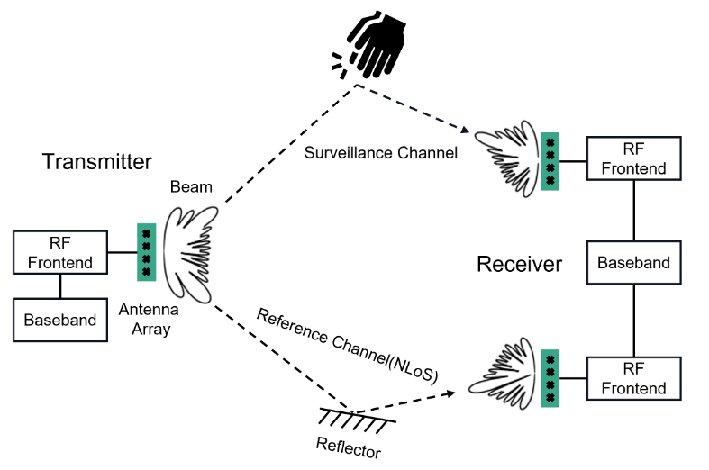
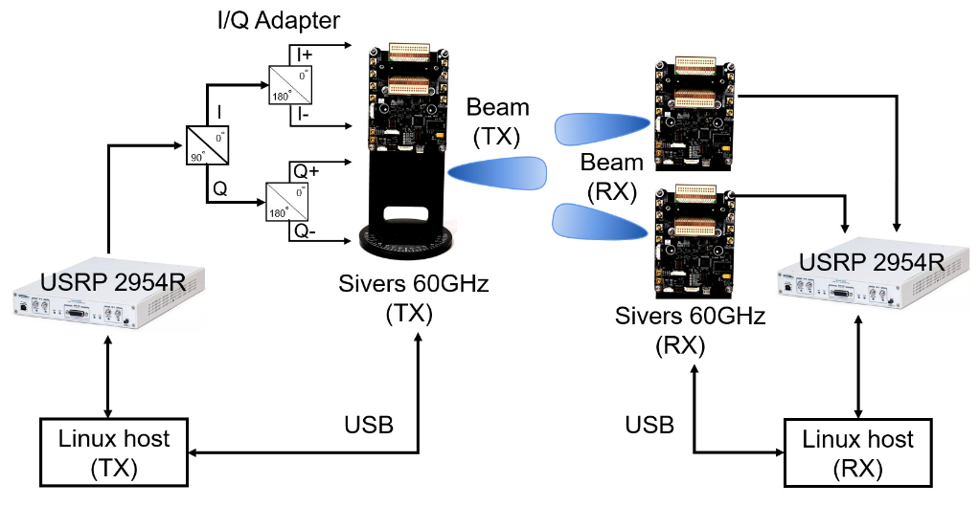
02.Preliminary
Activity Recognition via passive mmWave Sensing System^{[4]}
Fig. Illustration of the passive gesture recognition system based on mmWave
[4] Li, J., Yu, C., Luo, Y., Sun, Y., & Wang, R. (2022). Passive Motion Detection via mmWave Communication System.

Slide 4
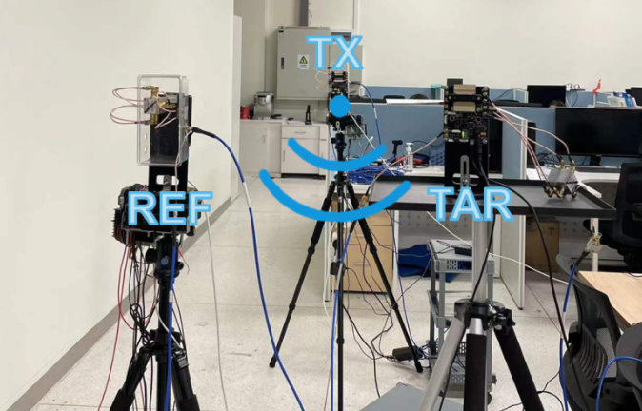
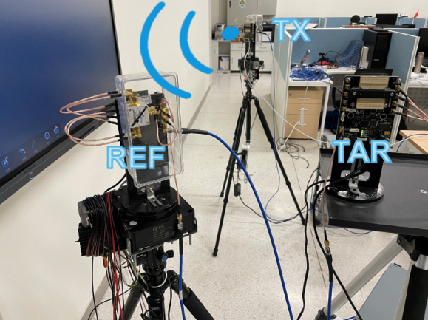
02.Preliminary
LOS Scenario
NLOS Scenario
[4] Li, J., Yu, C., Luo, Y., Sun, Y., & Wang, R. (2022). Passive Motion Detection via mmWave Communication System.

Slide 5
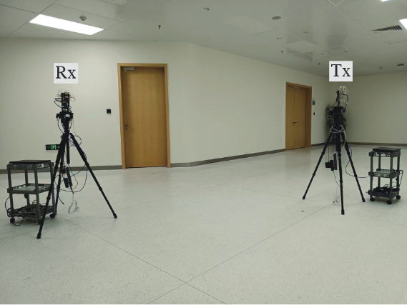
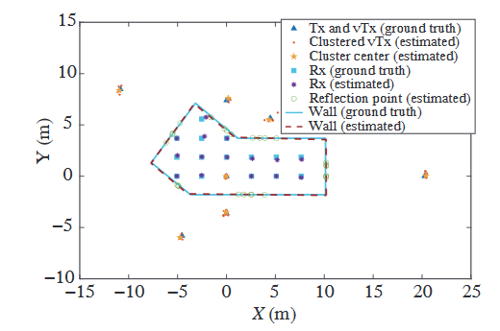
02.Preliminary
Indoor Localization system via passive mmWave Sensing System^{[5]}
Experimental environment of the corridor
Corridor layout reconstruction
[5] Sun Y, Li J, Zhang T, et al. An indoor environment sensing and localization system via mmWave phased array[J]. Journal of Communications and Information Networks, 2022, 7(4): 383-393.

Slide 6
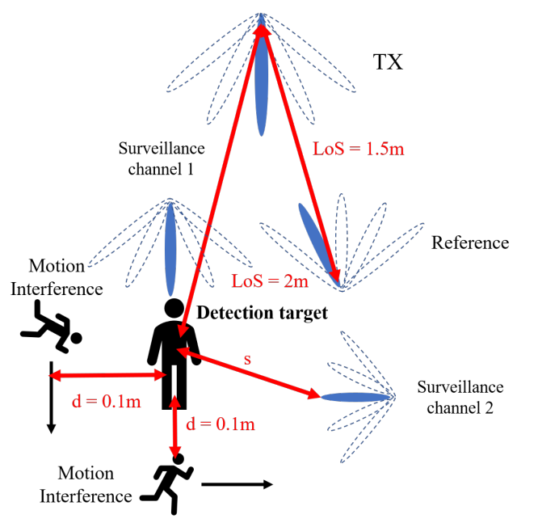
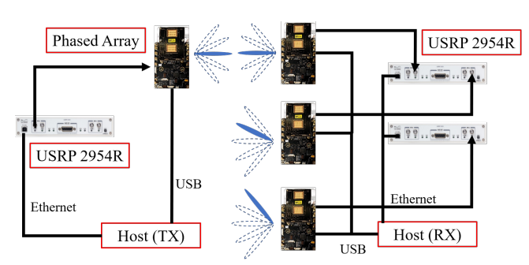
02.Preliminary
Human Respiration Detection system via passive mmWave Sensing System
Fig. Human Respiration Detection system

Slide 7
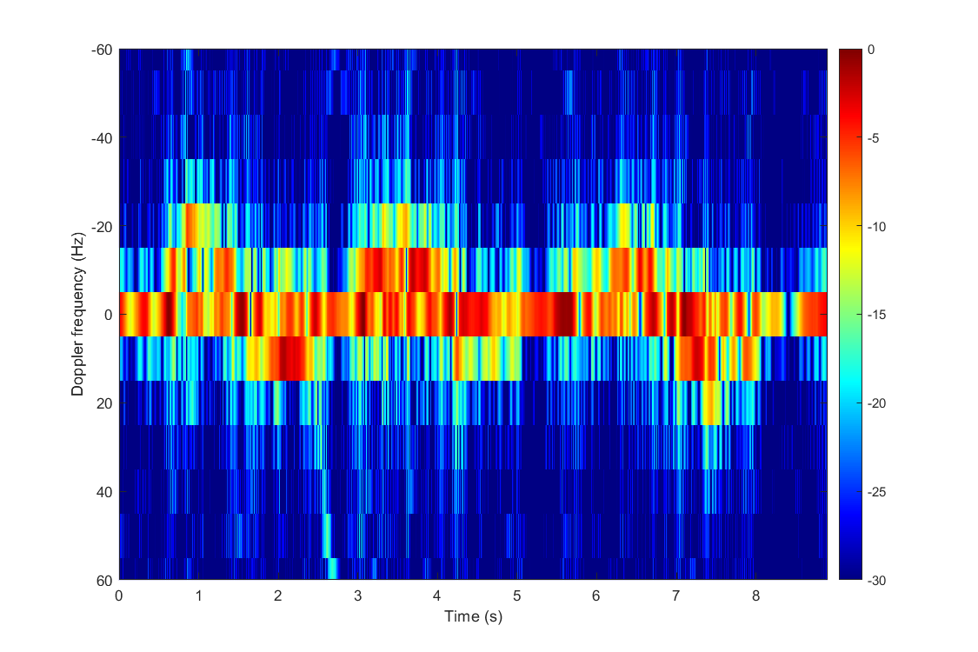
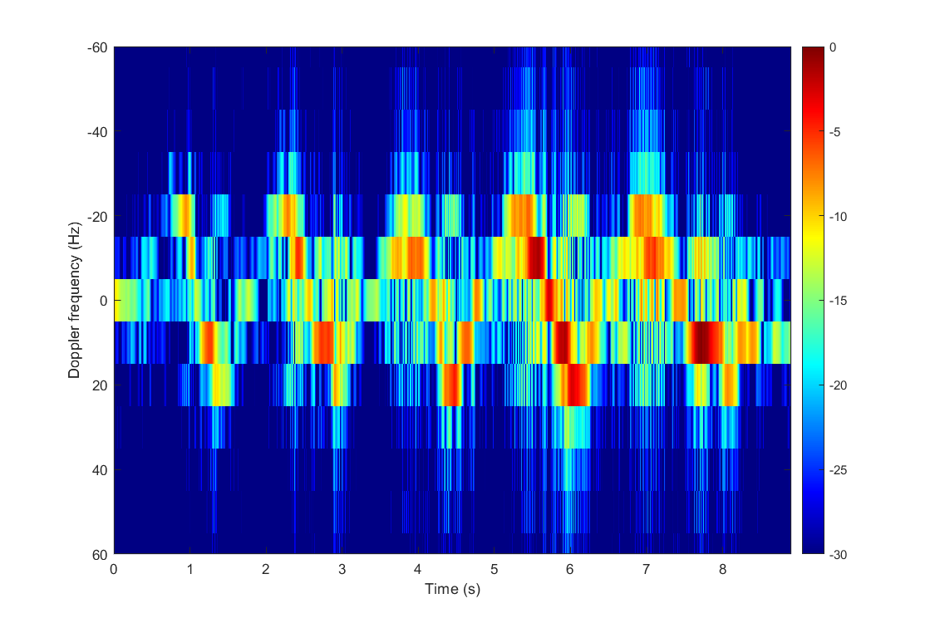
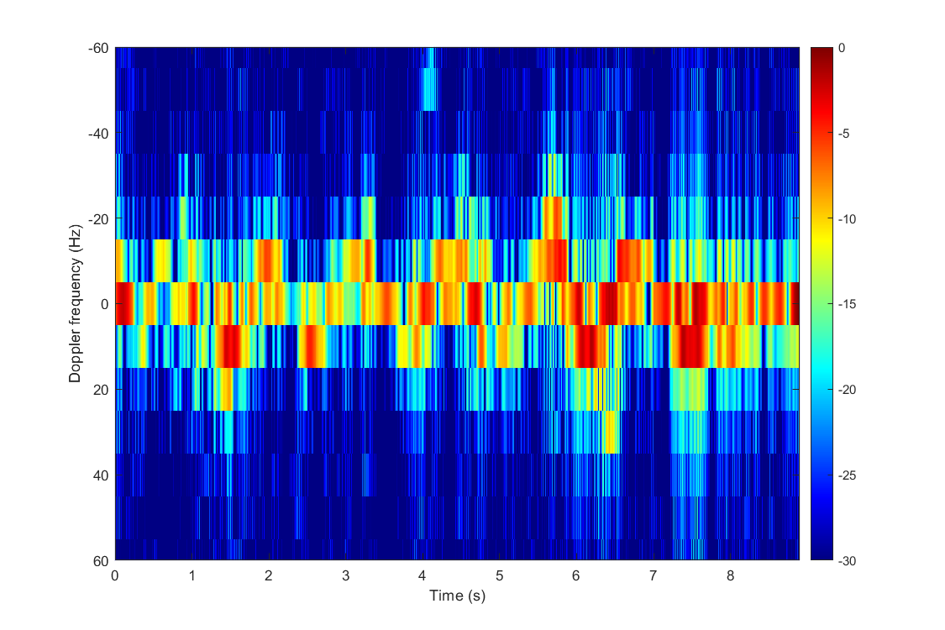
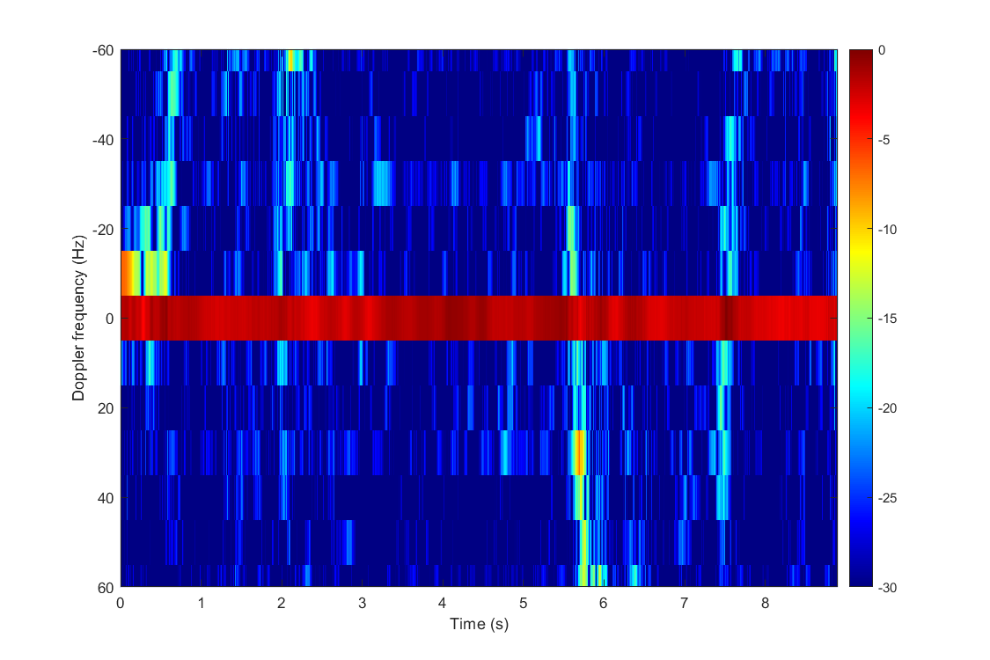
02.Preliminary
Human Respiration Detection system via passive mmWave Sensing System
均匀呼吸3次
均匀呼吸5次
均匀呼吸6次
无人呼吸

Slide 8
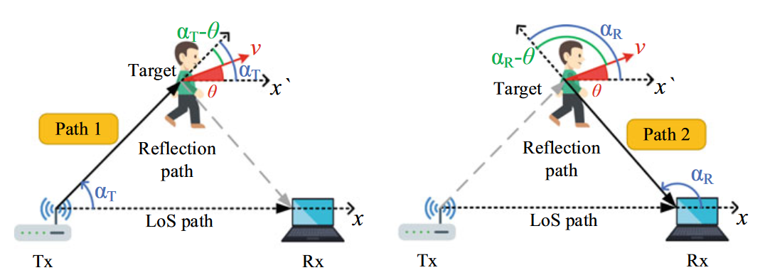
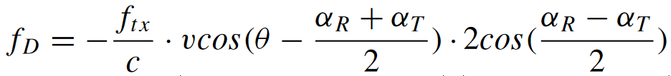
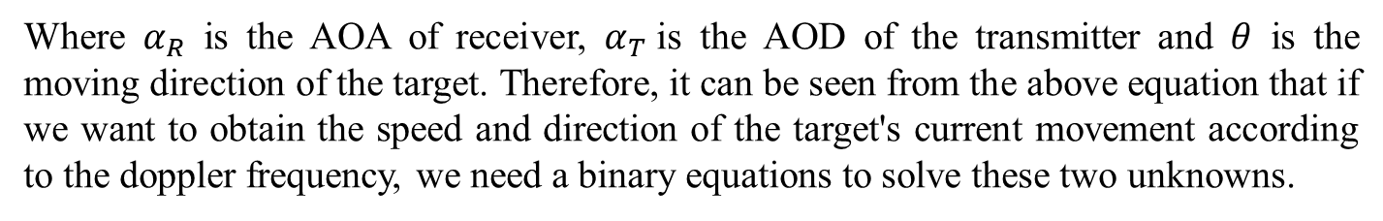
03.Theoretical Basis
Doppler-Velocity Model^{[6]}
Doppler frequency
Where $α_{R}$ is the AOA of receiver, $α_{T}$is the AOD of the transmitter and $θ$ is the moving direction of the target. Therefore, it can be seen from the above equation that if we want to obtain the speed and direction of the target's current movement according to the doppler frequency, we need a binary equations to solve these two unknowns.
[6] Niu K, Wang X, Zhang F, et al. Rethinking Doppler effect for accurate velocity estimation with commodity WiFi devices[J]. IEEE Journal on Selected Areas in Communications, 2022, 40(7): 2164-2178.

Slide 9

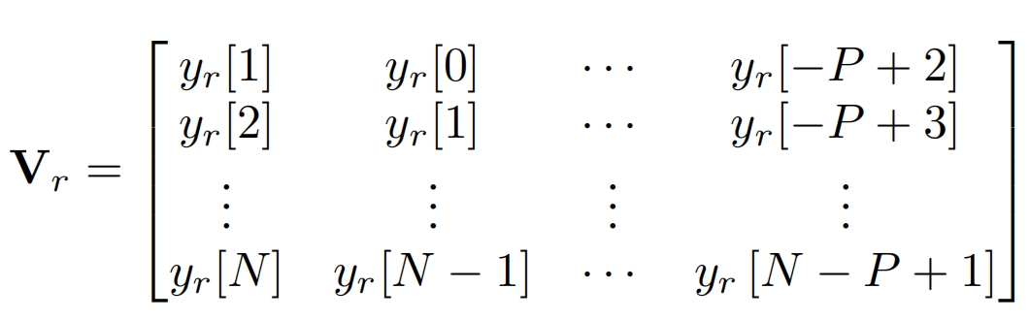


03.Theoretical Basis
The least-square-based (LS-based) clutter cancellation
Motivation: The signal components with zero Doppler frequency in surveillance channel (e.g. Strong LOS component) might interfere the estimation of target doppler frequency. Therefore, the LS-based clutter cancellation is applied for suppressing the above interference^{[7]}.
V_{r} is the matrix of delayed reference signal of the reference channel
V_{s} is the matrix of the surveillance channel
Fit the delay coefficient by the least square method
Surveillance channel signal after LS-based clutter cancellation
[7] D. K. Tan, H. Sun, Y. Lu, M. Lesturgie, and H. L. Chan, “Passive radar using global system for mobile communication signal: theory, implementation and measurements,” IEE Proceedings-Radar, Sonar and Navigation, vol. 152, no. 3, pp. 116–123, 2005.

Slide 10
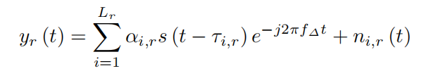
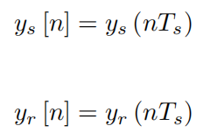
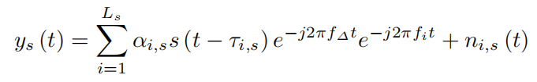
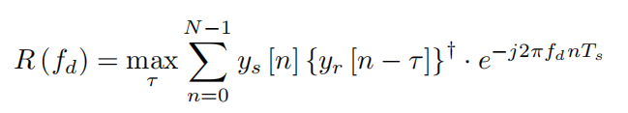
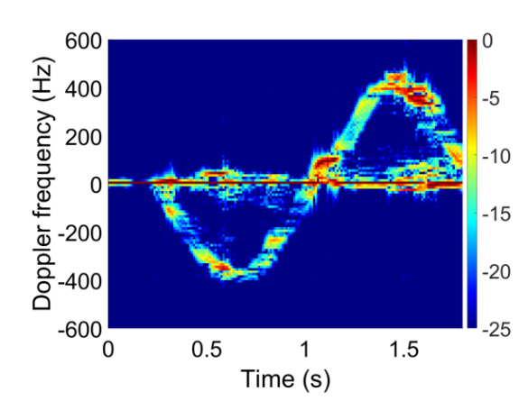
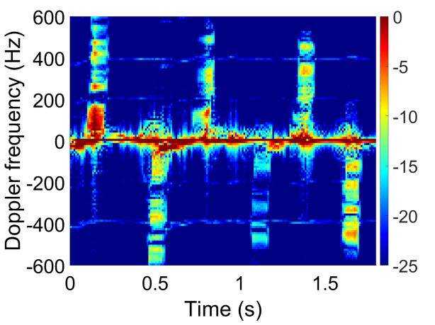
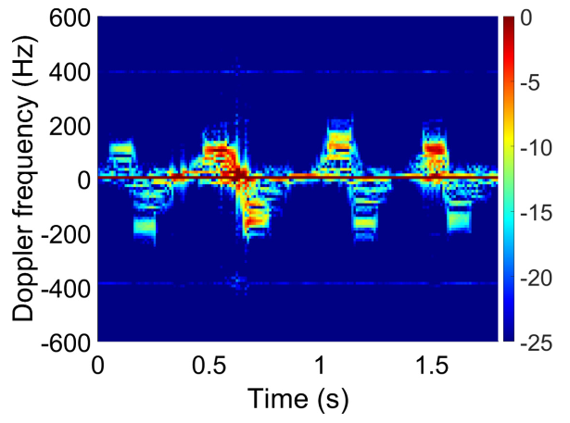
03.Theoretical Basis
CAF (Cross-Ambiguity Function)
采样
滑动时间窗口+互相关模糊函数得到时间-多普勒图
Fig. Different Gesture Spectrograms obtained: pushing hand, beckoned and rubbing finger^{[4]}
(From left to right)

Slide 11
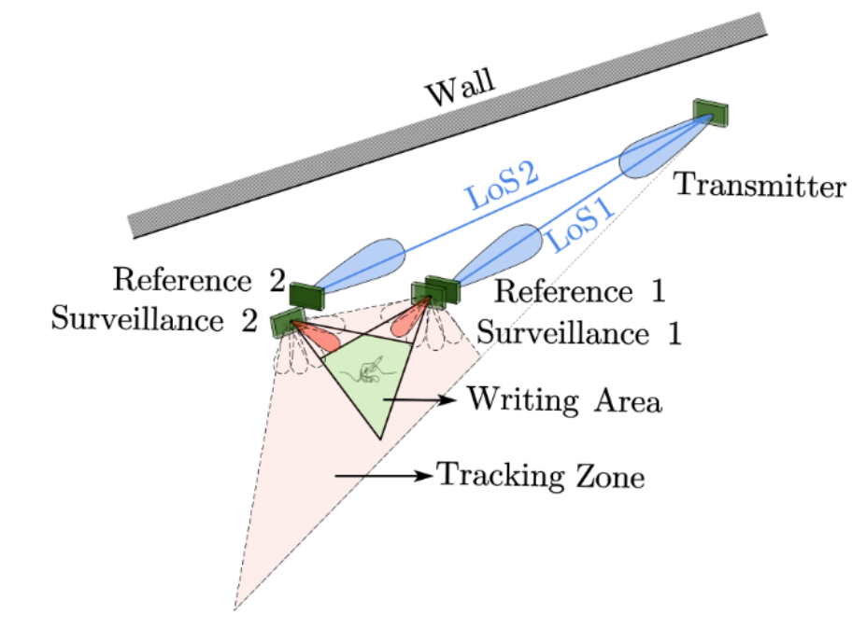
04.Expected System
Handwriting Tracking System
Add one or two new millimeter wave communication link (Considered as Reference channel 2 and Surveillance channel 2) in order to build two binary first order equations with doppler frequency.
Fig. Expected System

Slide 12
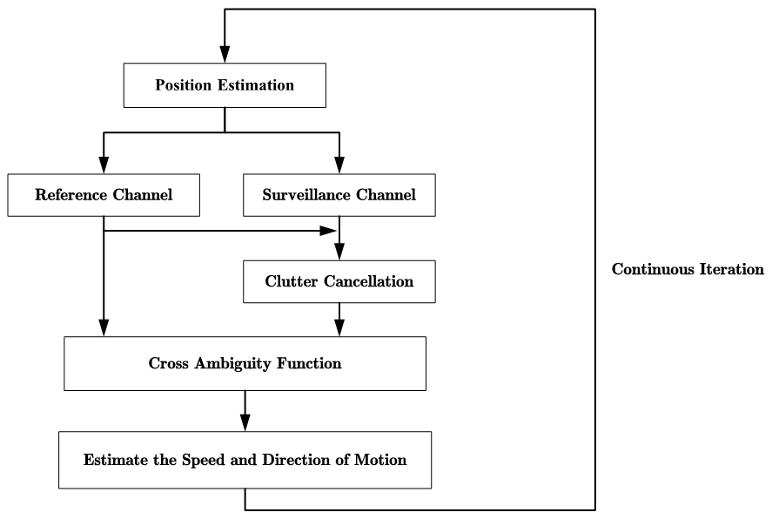
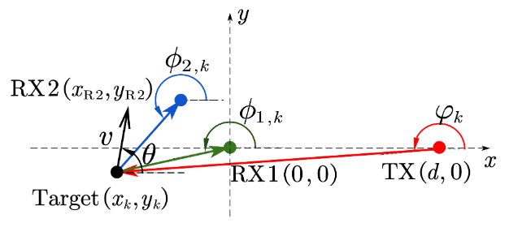
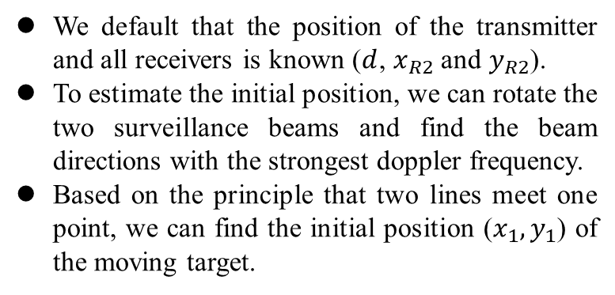
05.Processing Flow
Position Estimation (Initial)
We default that the position of the transmitter and all receivers is known ($d$, $x_{R2}$ and $y_{R2}$).
To estimate the initial position, we can rotate the two surveillance beams and find the beam directions with the strongest doppler frequency.
Based on the principle that two lines meet one point, we can find the initial position ($x_{1},y_{1}$) of the moving target.
Fig. Illustration of AoAs, AoD, and target’s mobility

Slide 13
05.Processing Flow
Clutter Cancellation
Clutter elimination based on what was described earlier.
Note that we have two surveillance channels and two reference channels (e.g. Ref1, Ref2, Sur1, and Sur2).
Therefore, our strategy for clutter elimination is to use the delayed copy of Ref1 to eliminate clutter in Sur1, and the delayed copy of Ref2 to eliminate clutter in Sur2.
CAF (Cross-Ambiguity Function)
CAF is performed on the four links of the two pairs of receivers to estimate the doppler shift of the two receiver based on the content described earlier.

Slide 14
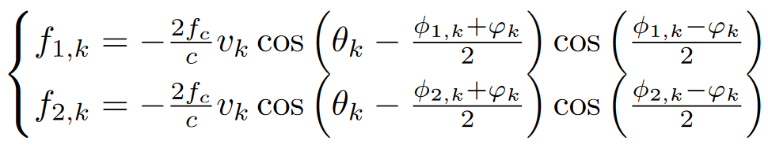
05.Processing Flow
Estimate the Speed and Direction of Motion
Fig. Illustration of AoAs, AoD, and target’s mobility
Based on what has been said before, we can list a binary system of first order equations consisting of two receiver Doppler frequencies:

Slide 15
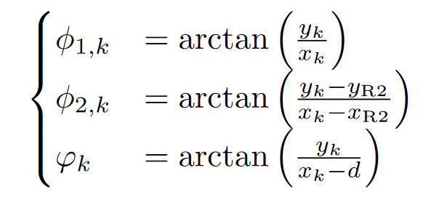
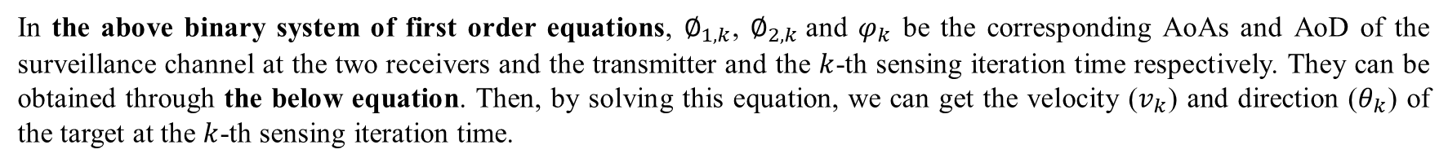
05.Processing Flow
Estimate the Speed and Direction of Motion
In the above binary system of first order equations, $∅_{1,k}$, $∅_{2,k}$and $φ_{k}$ be the corresponding AoAs and AoD of the surveillance channel at the two receivers and the transmitter and the $k$-th sensing iteration time respectively. They can be obtained through the below equation. Then, by solving this equation, we can get the velocity ($v_{k}$) and direction ($θ_{k}$) of the target at the $k$-th sensing iteration time.

Slide 16
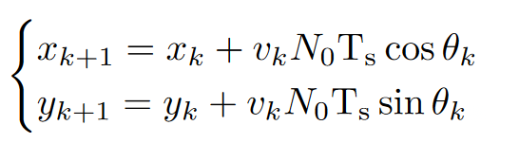
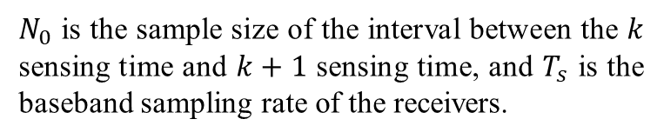
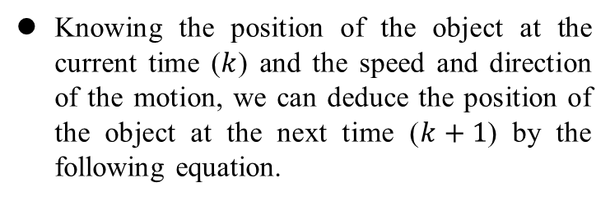
05.Processing Flow
Continuous Iteration
Knowing the position of the object at the current time ($k$) and the speed and direction of the motion, we can deduce the position of the object at the next time ($k+1$) by the following equation.
$N_{0}$ is the sample size of the interval between the $k$ sensing time and $k+1$ sensing time, and $T_{s}$ is the baseband sampling rate of the receivers.
At this point, we will continue to iterate and repeat the above process to achieve the continuous tracking of the target's motion trajectory.

Slide 17
06. Future Plan
基于实验室已有的毫米波被动雷达平台进行实验，使用上面提到的信号处理算法得出处理后的时间-多普勒图像(CAF依据实验室之前的Work实现，基于最小二乘法的杂波消除算法需要自己研究进行实现)。
利用两条监视信道处理后的时间-多普勒图像，结合每个传感时刻两个监视信道获得的多普勒频率与求解二元一次方程，得到物体当前时刻的运动速度与方向。
不断迭代上述过程来实现对感知目标(手写笔)的追踪。
通过分析我们获得的追踪笔迹与Ground Truth的偏差，通过绘制CDF来说明我们方案的追踪误差分布如何。
尝试当发射机与参考信道之间的路径为NLOS时(例如经由墙壁或障碍物反射，此时接收信号强度将比LOS情形大大降低)，我们的追踪误差分布相比上面的LOS情况将如何变化。

Slide 18

Thanks for watching！
Notes:
请各位专家老师批评指正！

Slide 19
Q&A
Notes:
请各位专家老师批评指正！

